Slide 1



Data Science Bootcamp
Predictive Analysis on House Prices
Team 1:
Alisha Punwani

Slide 2



Project
Introduction
Step into the captivating world of predicting housing prices! In this project, we embark on a journey inspired by the groundbreaking research of Harrison and Rubinfeld (1978) and enriched by the insights from Belsley, Kuh, and Welsch (1980) on Regression Diagnostics.
Our dataset, though modest, presents an intriguing challenge with its intricate interplay of factors: house area, bedroom count, furnishing details, and proximity to the main road. The true essence lies in crafting a predictive model that adeptly navigates through the complexities of multicollinearity.
Join us as we uncover the unique stories woven into each data point, exploring the delicate equilibrium between cozy bedrooms and lively main roads, all in the pursuit of mastering the nuanced art of housing price prediction.
Data Source:
https://www.kaggle.com/datasets/yasserh/housing-prices-dataset/data

Slide 3
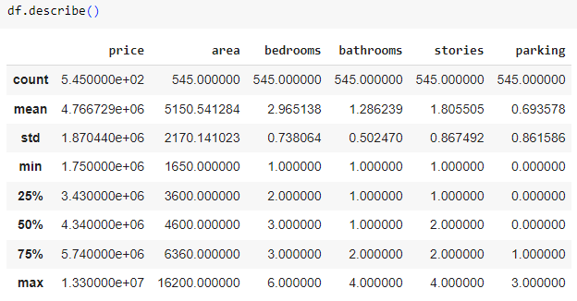
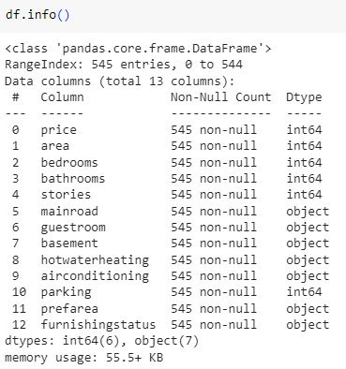
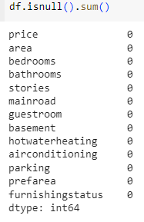
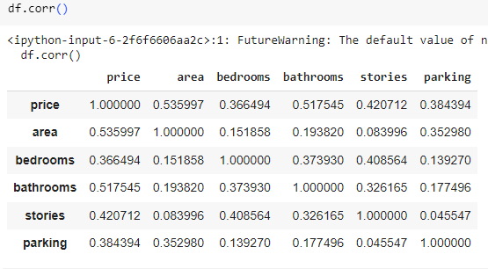
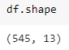
OUR APPROACH:
Analyzing the Dataset
Outliers Investigation: We meticulously combed through the dataset, identifying and addressing outliers that could potentially skew our analysis or modeling.
Handling Null Values: Recognizing the importance of data integrity, we systematically dealt with any null values, ensuring a robust foundation for subsequent steps.
Identifying Dissimilarities: Our scrutiny extended to uncovering dissimilarities in the data, understanding variations that could influence the predictive outcome.
Correlation Discovery & Identifying Data Patterns: Employing correlation analysis, we identified and explored relationships between different features, paving the way for informed decision-making in subsequent stages.

Slide 4
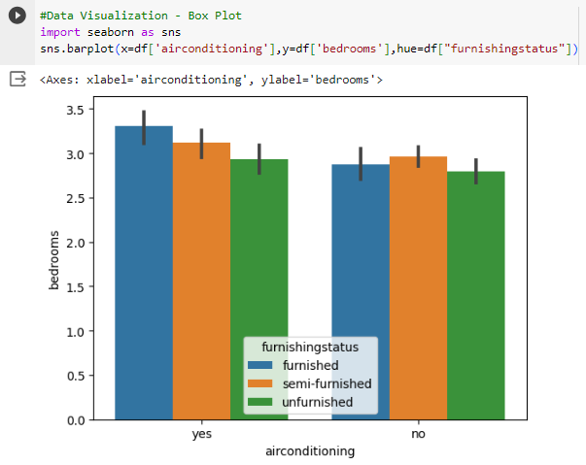
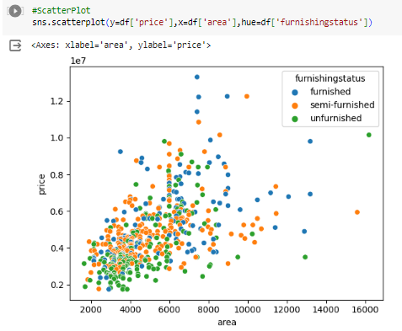
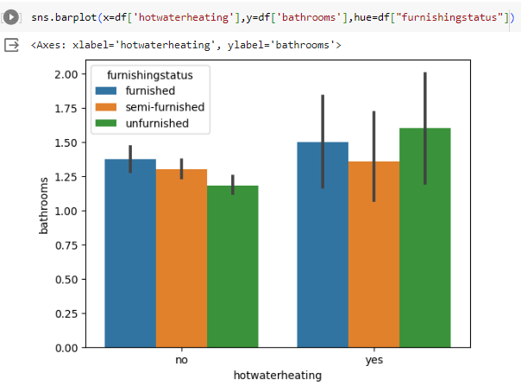
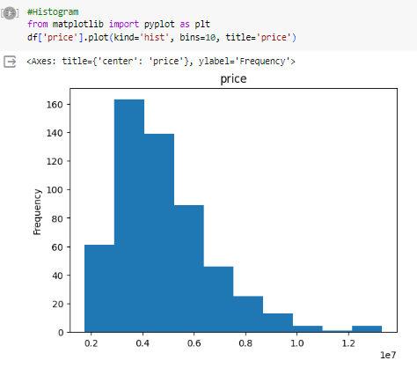
OUR APPROACH:
Exploring Through Visualization
Bar Plot: Visualized categorical data distribution using bar plots, offering a clear representation of the distribution of variables.
Box Plot: Leveraged box plots to gain insights into the distribution of numerical data, identifying central tendencies and potential outliers.
Heatmap: Employed heatmaps to visualize correlation matrices, providing a comprehensive overview of feature interdependencies.
Scatter Plot and Pair Plot: Utilized scatter plots for bivariate analysis and pair plots for multivariate exploration, offering a rich visual understanding of feature relationships.
Histogram: Employed histograms to illustrate the distribution of a single numerical variable, providing a detailed view of its frequency distribution.

Slide 5
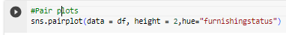
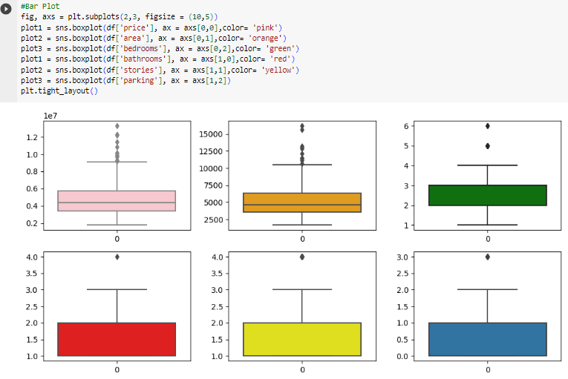
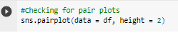
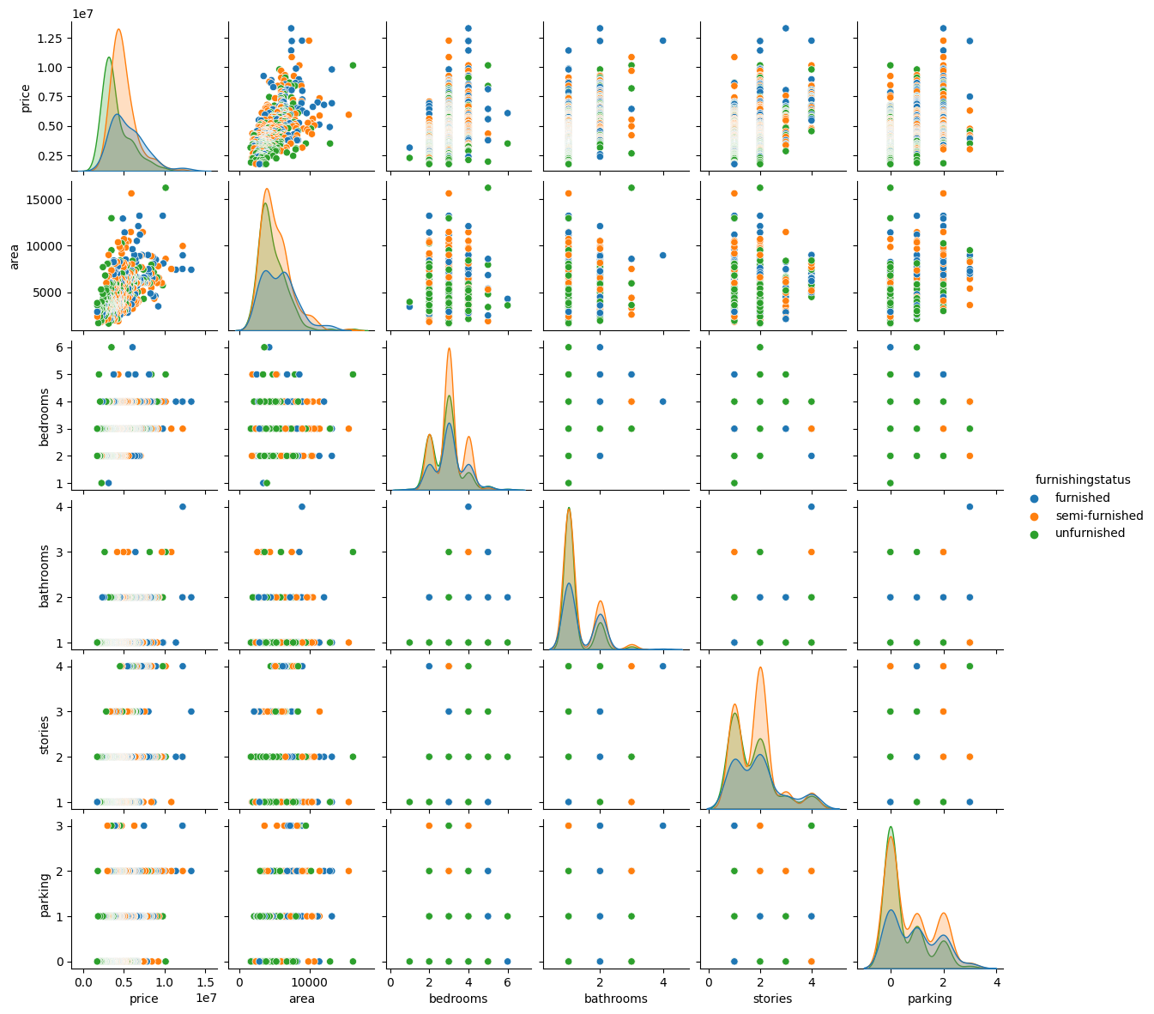
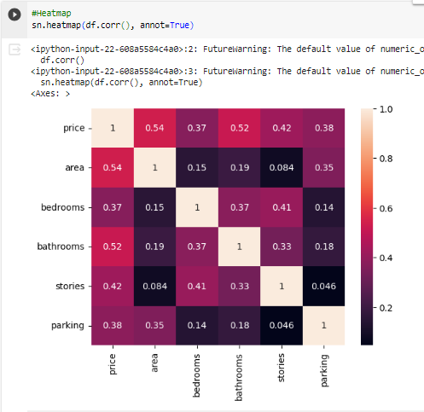
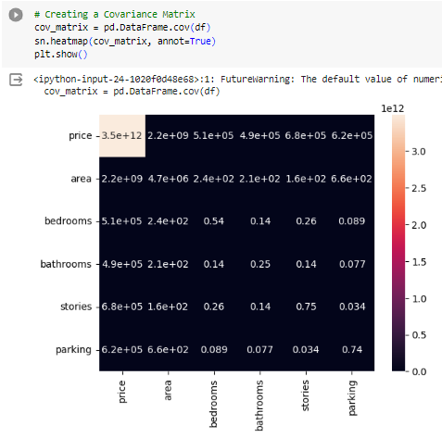

Slide 6
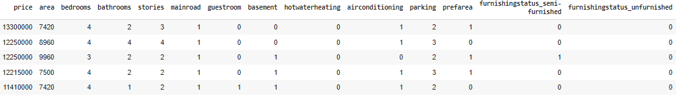
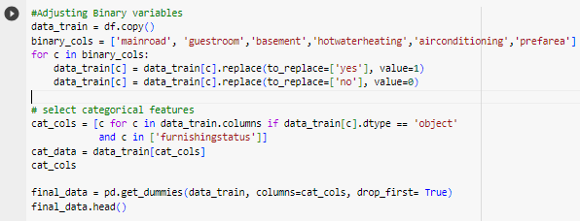
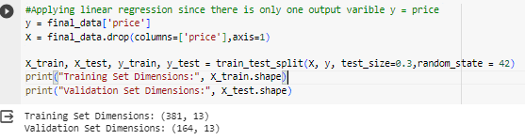
OUR APPROACH:
Feature Engineering
Binary Variable Adjustment: Recognizing the significance of binary variables, we meticulously adjusted categories like 'mainroad,' 'guestroom,' 'basement,' 'hotwaterheating,' 'airconditioning,' and 'prefarea.' These were transformed into a numeric format, where 'yes' became 1, and 'no' became 0, ensuring compatibility with our model requirements.
Categorical Feature Handling: A keen eye was cast on categorical features, with a specific focus on 'furnishingstatus.' Leveraging one-hot encoding, we transformed these categorical variables into numerical format, capturing their essence without falling into the multicollinearity trap. The result was a refined dataset, ready for the predictive modeling stage.
Data Snapshot: The adjusted and enhanced dataset, showcased in the initial rows, reflects the transformative impact of our feature engineering efforts. These steps not only set the stage for a more nuanced model but also positioned our data for improved interpretability and accuracy.

Slide 7
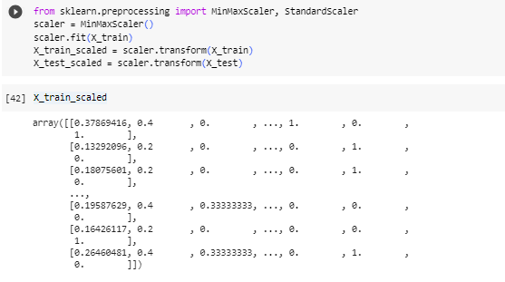
OUR APPROACH:
Feature Scaling
Scaling Method Selection: The chosen method, Min-Max Scaling, ensured a uniform scale for our features, minimizing the impact of differing ranges.
Scaler Training: The Min-Max Scaler was trained using the features from our training dataset (X_train). This step was crucial to calibrate the scaler and ensure that it appropriately normalized our features.
Application to Test Set: The trained scaler was then applied uniformly to our test set (X_test), ensuring consistency in scale across both training and evaluation data.
Contributing to Model Training: The process of feature scaling significantly contributed to the efficiency of our model training, allowing it to converge faster and preventing undue influence from features with larger scales.

Slide 8
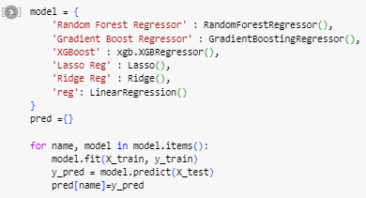
OUR APPROACH:
Training the model
Model Selection: Our journey into predictive modeling involved an ensemble of robust algorithms, each with its unique strengths. The lineup included the Random Forest Regressor, Gradient Boosting Regressor, XGBoost, Lasso Regression, Ridge Regression, and Linear Regression.
Training Procedure: Each model underwent training using the training dataset (X_train and y_train). This phase involved exposing the models to the patterns within our data, allowing them to learn and adapt to the nuances of housing price prediction.
Predictions Generated: The trained models were put to the test, generating predictions for the test set. The resulting predictions, captured in the 'pred' dictionary, would serve as a basis for evaluating each model's performance against the ground truth.
Diverse Approach for Holistic Insights: By employing a diverse set of algorithms, we aimed not only to capture nuanced patterns in the data but also to gain a holistic understanding of our dataset. This approach positions us well for a comprehensive evaluation and comparison of model performance.

Slide 9
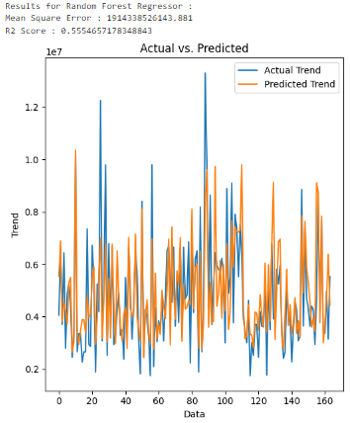

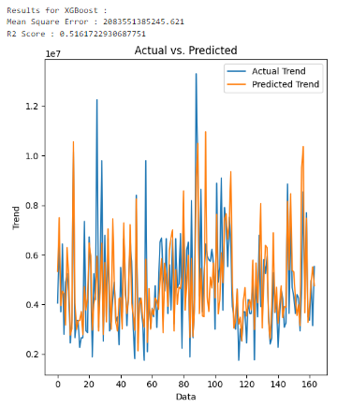
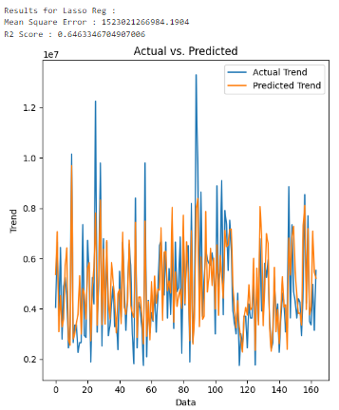
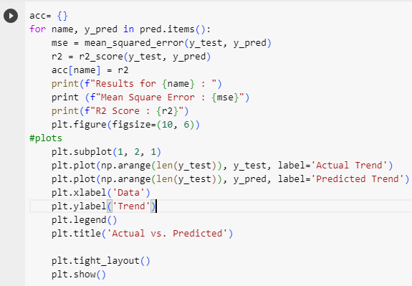
OUR APPROACH:
Assessing Model Performance
Performance Metrics: Rigorous evaluation was conducted for each model, with a focus on Mean Squared Error (MSE) and R-squared (R2) scores. These metrics provided quantifiable insights into the predictive accuracy and explanatory power of each model.
Visual Validation: The actual vs. predicted trends were visually validated through plotted comparisons. These graphical representations offered an intuitive understanding of how well each model captured the intricacies of housing price dynamics.

Slide 10
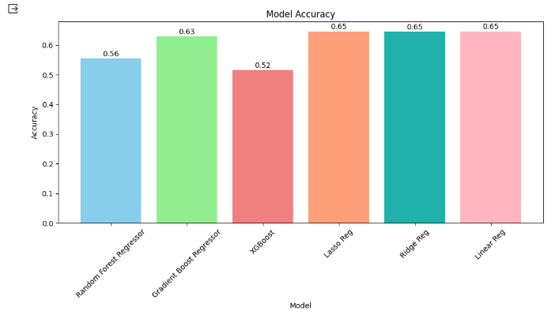
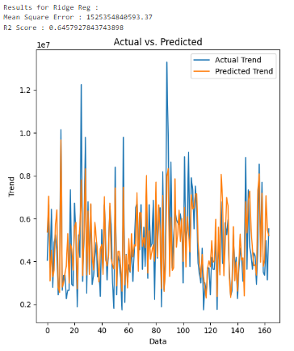

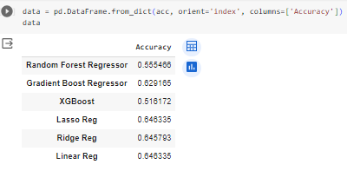
OUR APPROACH:
Assessing Model Performance
Random Forest Regressor: Achieved a moderate accuracy of 0.555466, indicating reasonable predictive performance
Gradient Boost Regressor: Outperformed other models with a relatively higher accuracy of 0.629165, showcasing its efficacy in capturing housing price dynamics.
XGBoost: Demonstrated comparable performance with an accuracy of 0.516172, positioning it as a competitive choice among the models.
Lasso Reg: Showcased robust performance, leading the pack with the highest accuracy of 0.646335, indicating its effectiveness in the regression task.
Ridge Reg: Achieved a similar high accuracy of 0.645793, suggesting its resilience and capability in predicting housing prices.
Linear Reg: Delivered performance on par with Lasso Reg, sharing the top spot with an accuracy of 0.646335.

Slide 11
THANK YOU

